Slide 1
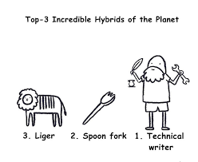
The TECHNICAL STYLE

Slide 2
Style in Writing
Consider the following:
Vocabulary: type, sophistication, complexity
(long, multisyllabic words)
Sentences: length, structure, impact
(how is the key information arranged and communicated)
Document structure (layout and presentation of information): headings, font, format

Slide 3
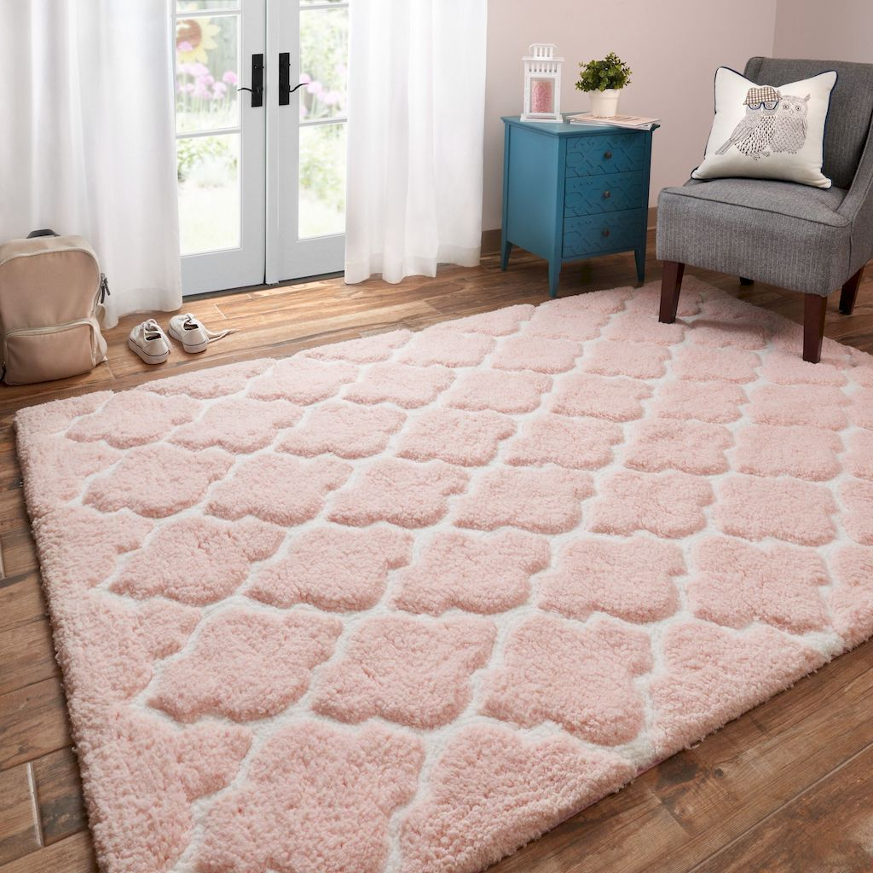
Do you remember the image below?

Slide 4
Compare the style
TEXT A
One enters the palatial room through an elegantly carved maple door to reveal the French provincial furniture of another century. The plush beige carpet makes one want to
run and dance barefoot.
TEXT B
The entrance to the 24-ft room is a 36-in. by 80-in. maple door decorated with a carved family crest. The floor has a beige nylon carpet with a 1-in. pad. The furniture is French provincial.

Slide 5
The TECHNICAL STYLE
The following acronym sums it all up.
SCOPE

Slide 6
This is SCOPE
S- Simplicity
C- Clarity
O- Objectivity
P- Precision
E- Economy

Slide 7
We will change the order to study!
Clarity
Precision
Simplicity
Objectivity
Economy

Slide 8
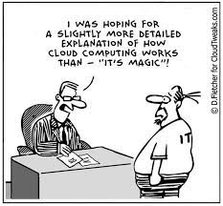

Slide 9
CLARITY
Getting the meaning from your head to the head of your reader accurately is the purpose of clarity.
Consequences of lack of clarity:
If the audience responds to a memo, letter, report, or manual with,
“Huh?” what has the writer accomplished?
If the correspondence is not clearly understood, the reader will either contact all the writer for further clarification, or just ignore the information. In either case, the writer’s time is wasted; the reader’s time is wasted; the message is lost.

Slide 10

Consequences of lack of clarity
.
Imagine:
Your company has written an installation manual for a
product. The manual, unfortunately, is not clear.
If the reader fails to understand the content, what negative consequences can occur?

Slide 11
Consequences of lack of clarity
It can be:
BAD—The equipment is damaged. This requires the owner to ship the equipment back. The company will replace the equipment,cost,and public relations have been frayed.
WORSE—The owner is hurt, leading to pain, anxiety, doctor’s bills, and bad public relations.
EVEN WORSE—The company is sued. The company loses money,the writer of the manual loses a job,and public relations are severed.

Slide 12
Strategies to achieve CLARITY
Completeness
Should answer all “WH” questions
Correct Grammar
Fonf
Pronoun References
Implied reference
Clear Organization
Cohesion and coherence
Vague reference
Ambiguous reference
Other mechanics and punctuations
Clear progression of ideas

Slide 13
1- Clarity: Completeness
a- Wh-Question:
Which version is better?
Version 1:
Date: March 5, 2004
To: Michelle Fields From: Earl Eddings
Subject: Meeting
Please plan to prepare a presentation on sales. Make sure the information is very detailed. Thanks.

Slide 14
1- Clarity: Completeness
Version 2:
Date: March 5, 2004
To: Michelle Fields From: Earl Eddings
Subject: Sales Staff Meeting
Please make a presentation on improved sales techniques for our sales
staff. This meeting is planned for March 18, 2004, in Conference Room C,
from 8:00 a.m. - 5:00 p.m.
Our quarterly sales are down 27%. Thus, we need to help our staff
accomplish the following:
1. Make new contacts.
2. Close deals more effectively.
3. Earn a 40% profit margin on all sales.
Use our new multimedia presentation system to make your presentation. With your help, I know our company can get back on track.
Thanks.

Slide 15
Rewrite the following email, providing the necessary information.
“The new admit cards can be collected from the admin block.”

Slide 16
2- CLARITY: Correct Grammar
What leads to correct grammar?
The Structures
Tenses,
Voice
Conditionals
Articles
Sentence Structure
Conjunctions
Clauses
Mechanics & Punctuation
Punctuation marks
Capitalization
Spelling errors
Prepositions,
Modal verbs
Avoidance of sentential errors
Correct
Grammar

Slide 17
3- CLARITY: Organization of content
This includes:
Coherence and Cohesion
Create a clear progression of ideas
Divide the content into paragraphs/sections
Use the writing process effectively

Slide 18
4- CLARITY: Pronoun Reference
Antecedent: Any subject/noun/word that a
pronoun refers to,
A pronoun’s reference will be unclear if it is:
Ambiguous
Implied
Vague or indefinite.

Slide 19
4- CLARITY: Pronoun Reference
a. Ambiguous Reference:
when the pronoun could refer to two possible antecedents.
Example:
The client told James that he had to come to therapy.
Revised:
The client told James, “You have to come to therapy.”

Slide 20
4- CLARITY: Pronoun Reference
b. Implied Reference
There should be a specific antecedent, not to a word that is Implied but is not stated in the sentence.
Example:
After braiding Ann’s hair, Sue decorated them with ribbons.
In Dan Brown’s Da Vinci Code , he writes extensively about art, history and arcane theories.

Slide 21
4- CLARITY: Pronoun Reference
C. Vague Reference: this, that, which
These pronouns should refer to specific antecedents.
When a pronoun’s reference is too vague, replace the pronoun with a noun.
Example:
“More and more often, especially in large cities, we are finding ourselves victims of serious crimes. We learn to accept this with minor complaints.”
Revised:
“More and more often, especially in large cites, we are finding ourselves victims of serious crimes. We learn to accept our fate with minor complaints.
(The pronoun this is replaced by the noun fate).

Slide 22
c. Vague Reference: (this, that, which)
When a pronoun’s reference is too vague, supply an antecedent to which the pronoun clearly refers.
Example:
Sue and Patsy were both too young to have acquired much wisdom, which accounts for their rash actions.
Revised
Sue and Patsy were both too young to have acquired much wisdom, a fact which accounts for their rash decisions.
(The pronoun which clearly refers to the supplied antecedent, fact).

Slide 23
CLARITY
Important!
CLARITY, in addition to following the
mentioned strategies, also depends to a great extent on the other qualities of TW.

Slide 24
Activity
You are the president of an industry association and have received the following inquiry from an out
of town member,
“I think I would like to attend my first meeting of the association even though I am not acquainted with your city. Will you please tell me where the next meeting is being held?”
Respond to the query above answering all the questions.

Slide 25
PRECISION
Precision refers to exact, definite, and distinct terms/words/details for expressing an idea. It will leave no room for misinterpretation or multiple interpretations.
Study the following examples and state which is precise and what technique has the writer used to achieve precision.
SET 1 | SET 2
Some of our competitors have very good businesses. As we discussed recently, I have the figures on the projects. The policy change will affect us adversely. | Both Sunbelt Instruments, Inc. and Ohio Testing laboratories grossed over $6.2 million during the fourth quarter of last year. I have discussed the comparative costs of three word processing computers which you requested in our telephone conversation last Friday. New Policy 1204.05 (Leaves) will decrease our allowable sick days from 10 to 8 per year.

Slide 26
PRECISION
Follow these strategies to achieve precision.
1. Choose concrete, and specific words.
Vague and Ambiguous | Clear and Precise
The flow of lava was affected. | The flow of lava was decreased.
The lacquer created nice appearance. | The lacquer created a glossy appearance.
Since the component was rejected, a new manufacturing process was developed. | Because/After the component was rejected; a new manufacturing process was developed.
This is the last carburetor to be installed. | This is the most recent carburetor to be installed.

Slide 27
PRECISION
2. Use Specific Facts and Figures
.
Vague, General, Indefinite | Concrete, Precise
This is a long letter. | This letter is three times as long as you said it would.
Student GMAT scores are higher. | In 1996, the GMAT scores averaged 600; by 1997 they had risen to 610.

Slide 28
PRECISION
Correct the text to achieve precision.
Our latest attempt at molding protectors has led to some positive results. We spent several hours in Dept. 15 typing different machine settings and techniques.
Several good parts were molded using two different
sheet thicknesses. Here’s summary of the findings.
First, we tried the thick sheet material. At 240F, this
thickness worked well.
Next, we tried the thinner sheet material. The thinner material is less forgiving, but after a few adjustments we were making good parts. Still, the thin material caused the most handling problems.

Slide 29
PRECISION
A better version
During the week of 10/4/14, we spent approximately 12 hours in Dept. 15 trying different machine settings, techniques, and thicknesses to mold mold protectors. Here is a report on our
findings.
0.030″ Thick sheet
At 240 F, this thickness worked well.
0.015″ Thick sheet
This material is less forgiving, but after decreasing the heat to 200F, we could produce good parts. Still, material at 0.015″ causes handling problems.

